Slide 1
Cloud Powered Data Analysis: A Case Study in Scalable Analytics
(AWS)
Team Members:
Barathkumar Anantharaj
Harshith Maddala
Siddharth Saravanan

Slide 2




Features Implemented
IAM
S3
Glue DataBrew
QuickSight
Ensures secure access to your AWS resources, including S3 and QuickSight.
Acts as the data source for AWS QuickSight.
Used for ETL of data before analysis.
A business intelligence (BI) service for creating dashboards and visualizations.

Slide 3
SCOPE OF THE PROJECT
Store raw data securely in Amazon S3 and clean it using AWS Glue DataBrew for efficient preprocessing.
Use AWS Glue for ETL and Amazon Athena to run SQL queries on S3 data without managing databases
Leverage AWS QuickSight to create interactive dashboards, uncover trends, and generate real-time insights
AWS ensures fast, secure, and scalable data analysis with a serverless architecture, optimizing performance and cost

Slide 4

DATASET
We will be using an Anime dataset sourced from Kaggle, originally compiled from the popular website MyAnimeList.net
14000 observations
17 Variables

Slide 5
EXPECTED OUTCOMES
Raw data is cleaned, transformed, and stored efficiently in Amazon S3 using AWS Glue DataBrew
01
Clean & Structured Data
02
Scalable & Automated Workflow
The entire data analysis process is serverless, automated, and scalable, ensuring efficiency and cost-effectiveness.
03
Improved Data
Accessibility
Users can easily access and explore the dashboard to understand key trends and patterns.
04
Interactive
Dashboards
AWS QuickSight provides dynamic visualizations and insights from the processed data.

Slide 6


AWS Cloud Architecture
Data Processing Layer
IAM with S3 and QuickSight permissions
Data Storage Layer
Create
Upload
Import
Visualization Layer
Access
Csv file
Data

Slide 7



Data Flow
Data Processing Layer
Visualization Layer
AWS Glue DataBrew
Create
Quicksight Analysis
Visualizations
Apply
Amazon Quicksight
Create
Story
Transformations
Quicksight Story
Import Data
S3
Raw
S3
Cleaned
Publish
Data Storage Layer
Import
Export
Quicksight Dashboard
Data
Data

Slide 8

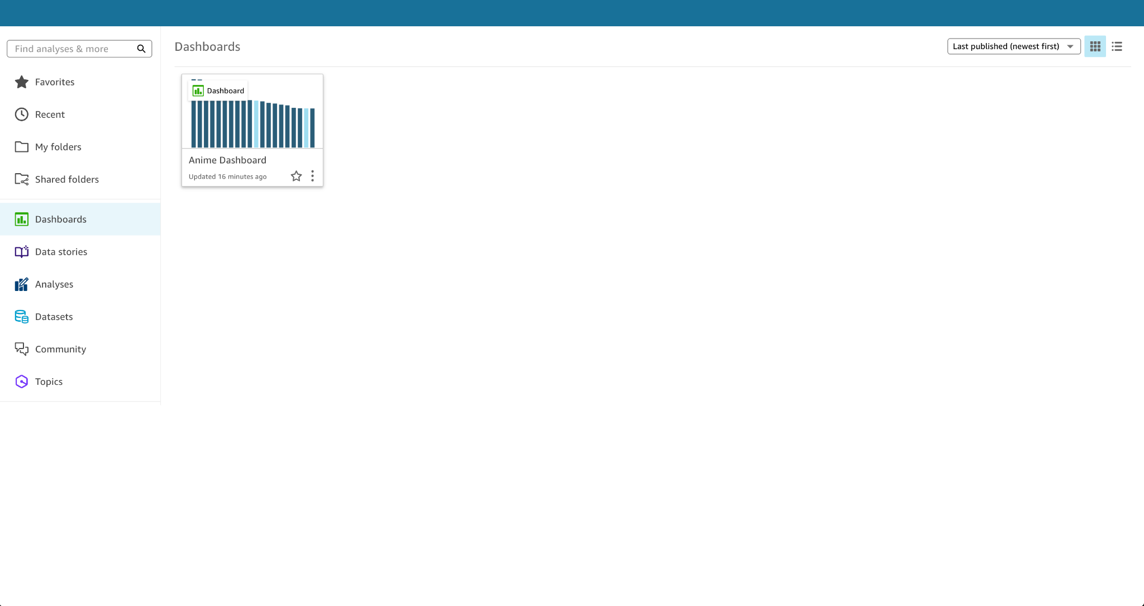
Project Implementation

Slide 9
IAM
We Create a IAM user and attach these policies:
AmazonS3FullAccess
AWSGlueDataBrewFullAccess
AWSQuicksightAthenaAccess

Slide 10
S3
We create a S3 Bucket with default settings and upload two files into it:
Dataset
Manifest file (Json)

Slide 11
Glue
DataBrew
We create a new project in DataBrew and import the dataset from S3 Bucket. We have completed the Following operations in DataBrew:
Removed Null valued rows from feature Theme.
Edited the Names of the Values in rows.
Eg: ActionAction -> Action
Edited the Numerical Values for more readability.

Slide 12
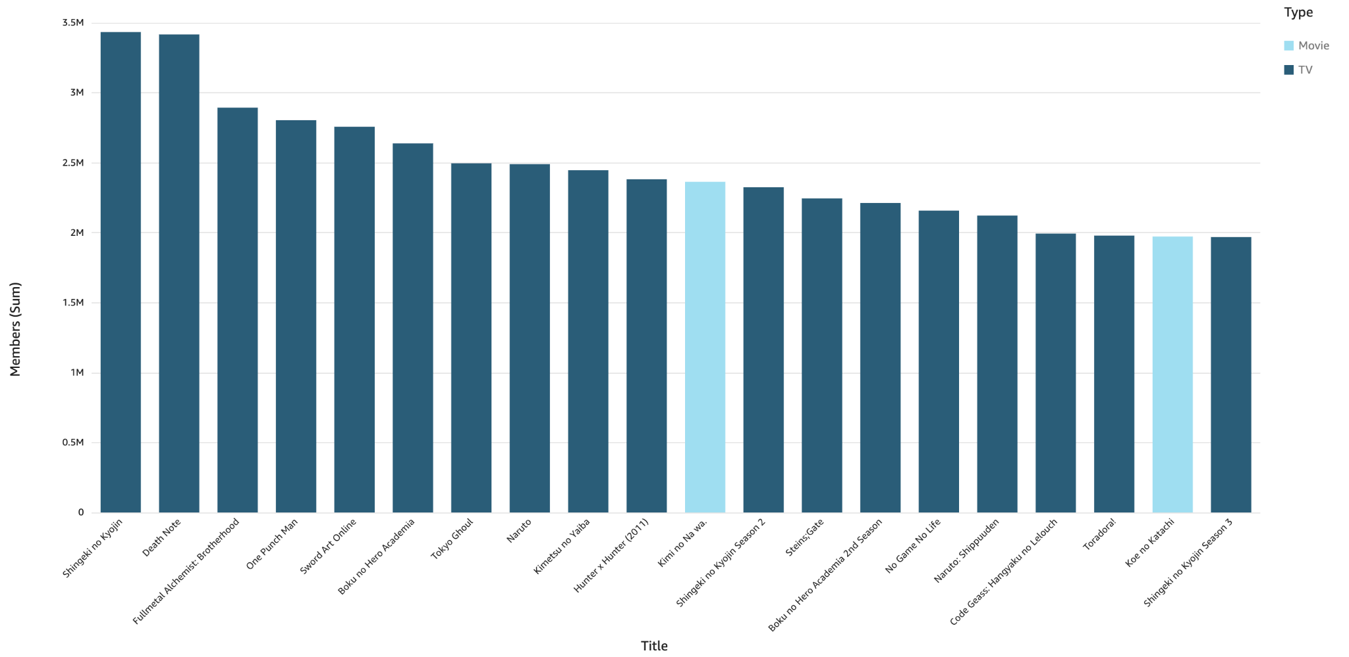
Which are the top 20 most popular anime titles by number of members, and are they mostly TV shows or movies?

Slide 13
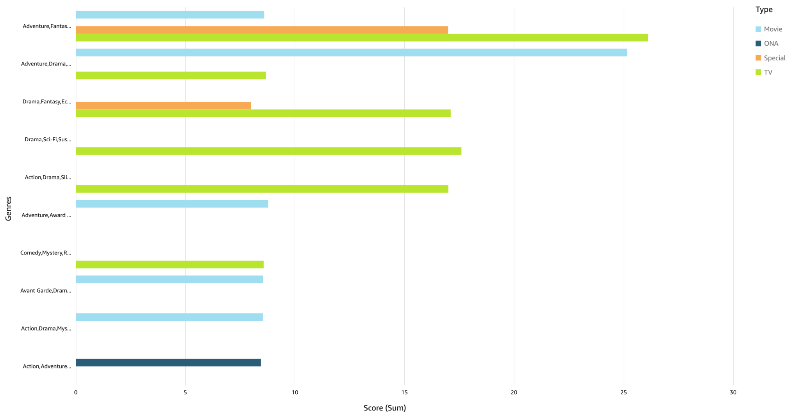
Which top 10 genre combinations have the highest average anime scores?

Slide 14
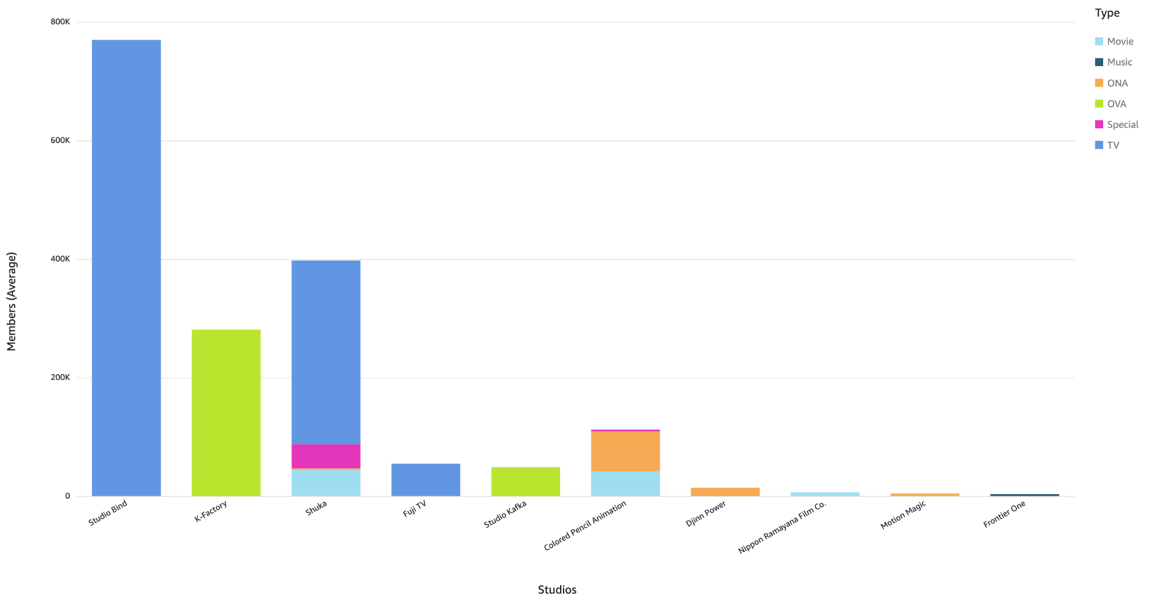
Which top 10 studios have the highest average member counts, and how are their anime types distributed?

Slide 15
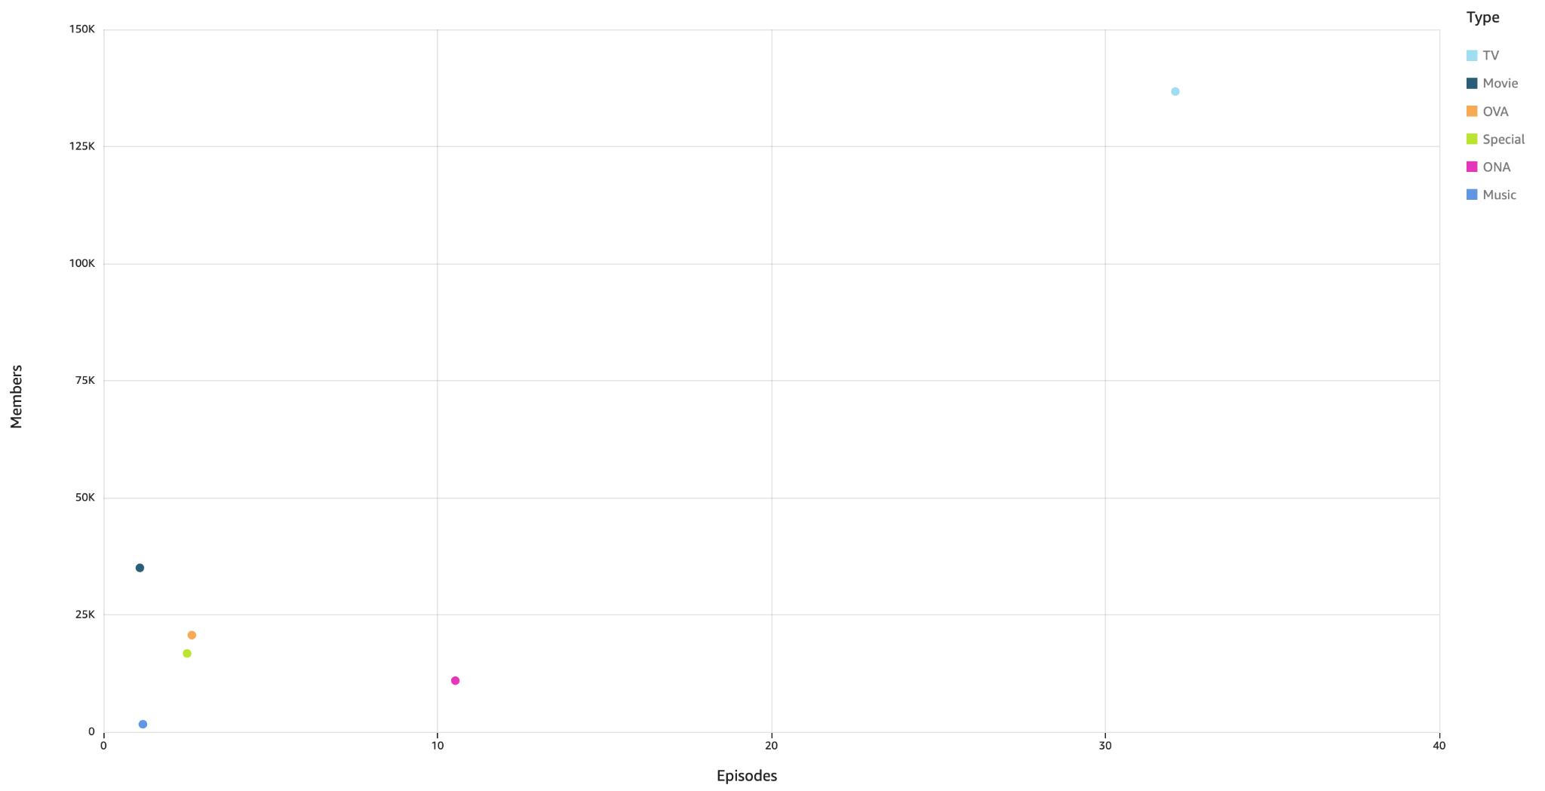
How does the number of episodes relate to the average member count across different anime types?

Slide 16
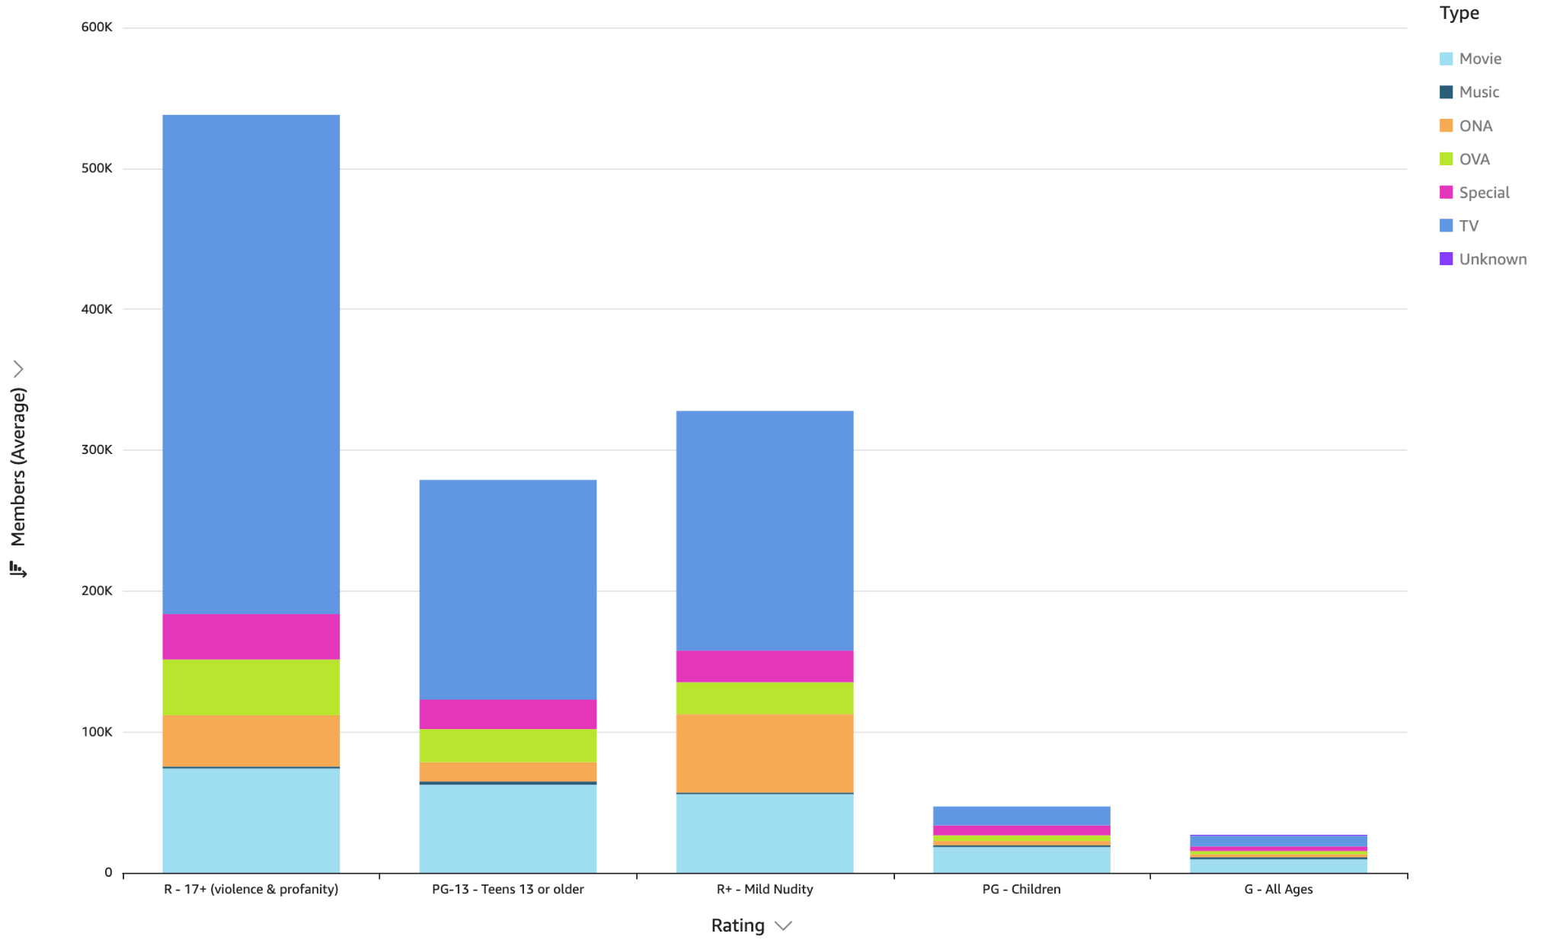
Which anime ratings are associated with the highest average number of members, across different types?

Slide 17
Insights
The top 20 most popular animes are overwhelmingly TV shows, highlighting the dominance of long-form content.
High-scoring animes commonly blend genres like Drama, Sci-Fi, and Mystery, and other combinations like Action, Adventure and Fantasy.
Studios like Studio Bind and Shuka lead in average member count, with a strong emphasis on TV productions over other anime formats.
TV shows with episodes on Average of 30+ tend to attract significantly more members, followed by movies, while shorter formats like OVAs and Specials see limited audience reach.
Anime with mature content (R-17+, R+ and PG-13) attract the highest average members, especially in the TV format, suggesting strong engagement with older audiences.

Slide 18

Thanks!
Do you have any questions?

